Slide 1
SOFT-SKILLS, MANAGEMENT, & TECHNOLOGY WORKSHOPS
MEASURE THE TRUE IMPACT OF LEARNING
ALL THE WAY TO ROI!
WITH DAVID LIEBERMAN, GRAVITY LEARNING FOUNDER
Notes:
https://gravitylearning.com/shrm-norcal-2023/

Slide 2
FOR LEADERS
WHY IS LEARNING OFTEN A “NICE TO HAVE”?
BECAUSE THERE’S NO “PROOF”

Slide 3
OUR MULTI-TOUCH LEARNING MODEL

Slide 4
WHAT IS A LEARNING INITIATIVE
YOU’RE WORKING ON OR WOULD LIKE TO SEE?

Slide 5
PROVE THE VALUE OF LEARNING

Slide 6
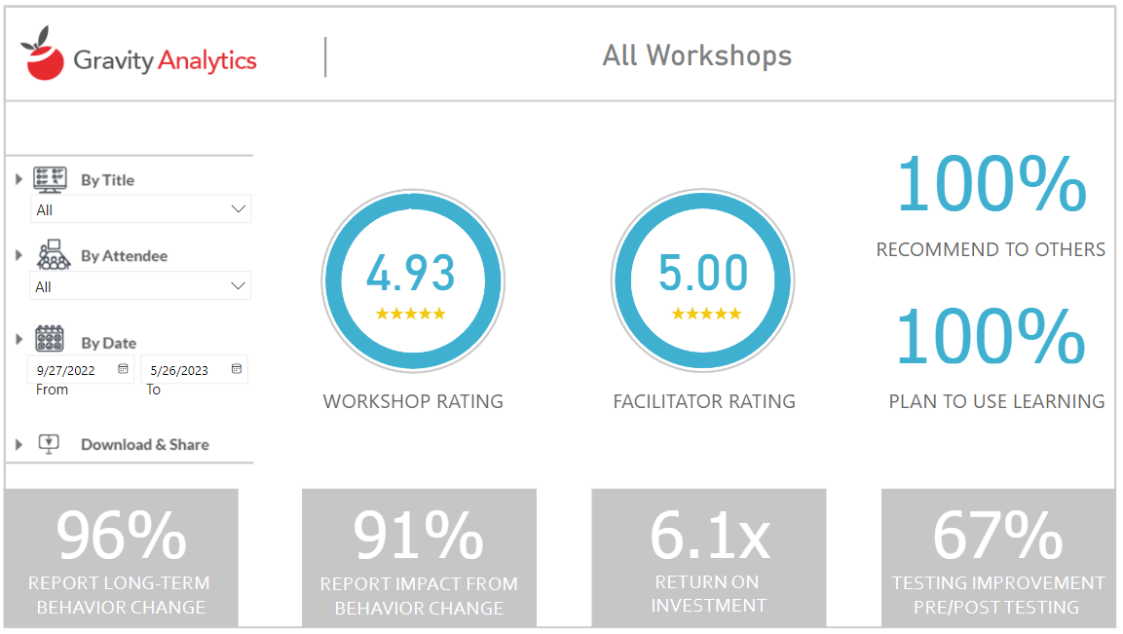
Notes:
The Gravity Dashboard. All clients get one. BTW, this is real data from one of our finance clients.

Slide 7
1
Reaction: What is the initial response to the learning?
KIRKPATRICK’S 4 LEVELS OF LEARNING EVALUATION
TAKEN UP A LEVEL
2
Learning:
Did people learn anything?
3
Behavior:
Did learners take action later?
4
Results:
Did their actions make an impact?
5
ROI:
Was it worth the money?

Slide 8
MEASURE IMMEDIATE REACTION
HAVE PARTICIPANTS FILL OUT THE SURVEY DURING CLASS
EXPLAIN WHY YOU’RE ASKING AND HOW THE INFO WILL BE USED
KEEP IT SHORT - ONLY ASK ABOUT THE ESSENTIALS
Notes:
Sample Reaction Survey: Keep it Simple!
https://form.jotform.com/212087304195150?wsid=TEST100&wsname=Sample%20Survey%20-Do%20Not%20Submit

Slide 9
PRE AND POST TESTING
PROVE PARTICIPANTS LEARNED
PRE & POST TEST PARTICIPANTS HAVE SIGNIFICANTLY BETTER RECALL
PRE-TESTING IS MORE EFFECTIVE THAN POST TESTING
PARTICIPANTS WHO WERE AWARE OF TESTING SPENT SIGNIFICANTLY MORE TIME AND EFFORT
Journal of Science of Learning (2019)
Notes:
Latimier, A., Riegert, A., Peyre, H., Ly, S. T., Casati, R., & Ramus, F. (2019). Does pre-testing promote better retention than post-testing?. NPJ science of learning, 4(1), 15.

Slide 10
MEASURE BEHAVIOR & IMPACT
ASK LEARNERS
AND LEADERS OF LEARNERS
1
DID BEHAVIOR CHANGE AS A RESULT OF THE LEARNING?
2
DID THE BEHAVIOR HAVE A VISIBLE IMPACT ON THE WORK?

Slide 11
QUANTIFYING THE VALUE OF A “SOFT” SKILL
PEOPLE LIKE TO SAY IT CAN’T BE DONE. PEOPLE ARE WRONG.
Notes:
Sample ROI Survey: https://form.jotform.com/221237514636150?wsid=EdenTest100&wsname=Modern%20Assertive%20Communication&wstopics=%E2%97%8F%20Assertiveness%20is%20at%20the%20crossroads%20of%20empathy%20and%20respect%0A%0A%E2%97%8F%20Frame%20your%20assertive%20statements%20by%20stating%20your%20goal%20before%20your%20statement%0A%0A%E2%97%8F%20Say%20No%20without%20backlash%20by%20-%20stating%20your%20reasons%20-%20saying%20something%20understanding%20-%20saying%20somethign%20helpful%20%0A%0A%E2%97%8F%20Reduce%20backlash%20by%20removing%20the%20word%20YOU%20from%20assertive%20statements

Slide 12
THE ROI FORMULA:
GROSS RETURN - COST
x 100
COST

Slide 13
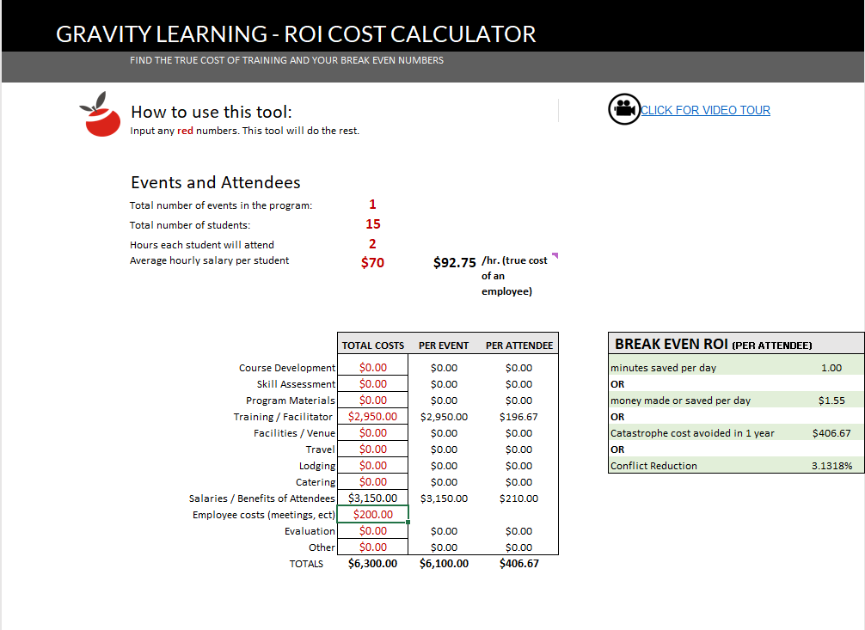
GET THE TRUE COST OF LEARNING
INCLUDE EVERY COST YOU CAN THINK OF
Download the Gravity Learning “Cost Of Learning” Calculator: link
Notes:
DOWNLOAD THE GRAVITY ROI CALCULATOR
https://gravitylearning.sharepoint.com/:x:/s/GravityLearningDocuments/EeXWAQ4PfOJEmspzjNrxyCEBHHJp4TBT11Nss-yGZGNcaA?e=kPpNwr

Slide 14
RETURNS
MUST BE CREDIBLE
Estimates must be corrected for confidence. If a resource is 50% confident, include 50% of their estimate.
No value can be assumed. If a value is not reported, zero value is counted.
“How confident are you in the accuracy of that estimate?”
Only quantifiable values are calculated. Intangible benefits certainly have value but are not included in ROI calculations.
“How confident are you that the effect was due to training?”
Ask for examples. Without examples, improvement measurements can be hard to trust.

Slide 15
MEASURING FOR TIME SAVED
Time Saved: How much time do you save as a result of your behavior changes??
ASK FOR AND REPORT EXAMPLES!
Time Saved for Others How much time do others save as a result of your behavior changes?
Confidence: How confident are you that you’re saving at least that much time? Reduce any estimates by the confidence rating.

Slide 16
Example time measurement
Estimate of time saved (minutes per day) | Confidence in estimate (%) | Corrected Estimate (estimate *confidence %) | Hours saved per year (corrected estimate / 60) * 240
10 | 50 | 5 | 20
Gross return
$2,000 (@ $100/hr)

Slide 17
SOME EMPLOYEES HAVE MORE VALUE THAN OTHERS
EVEN WITH THE SAME:
EXPERIENCE
EDUCATION
INTELLIGENCE
BACKGROUND
WHY?
THEY ARE MORE SKILLED IN KEY COMPETENCIES

Slide 18
OF KEY COMPETENCIES
FIRST
CALCULATE THE VALUE
1.
2.
3.
DETERMINE KEY COMPETENCIES FOR A ROLE
DETERMINE % OF COMPETENCY’S RESPONSIBILITY FOR SUCCESS
MULTIPLY % VS. SALARY TO GET VALUE OF COMPETENCY
Notes:
Assess the extent to which each competency contributes to success in the role.

Slide 19
MEASURE THE VALUE OF COMPETENCY GAIN
Rate a participant before and after learning on how closely they meet expectations for a competency.
Use a -4 to 4 scale where 0 is expected value
Each number from 0 is worth 25% of the competency
UTILITY MEASUREMENTS
Download the Gravity Learning Utility ROI Calculator: link
Notes:
DOWNLOAD THE UTILITY MEASUREMENT CALCULATOR: https://gravitylearning.sharepoint.com/:x:/s/GravityLearningDocuments/Ee28u2VWsfhKmFq8Np4I6swBKdcbo9eNnj1Dh6l6pF-m0Q?e=4ibncv
Determine competencies for a role.
Then determine how much success in the role each competency is responsible for. For example, competency in SQL might have a full 50% to do with job success. On a 100K salary, satisfactory SQL skills would be “worth” 50K.
Determine an employee’s current competency level -4 to 4
-4: This employees skill level is harmful to the org and costs at least the expected value
0: This employee demonstrates the minimum skill needed for job success (they are “worth it” to the org) If an employee is evaluated at a 5, their SQL skills are worth 50K.
4: This employee demonstrates skill that gains the org at least double the expected
After training, the employee is evaluated again, and each skill point change is worth 25% of 50K, or $12.5K

Slide 20
Example: competency measurement
Competency trained | Competency impact on success (%) | Value of competency (impact on success * salary) | Competency Rating Before (-4 to +4) | Competency Rating After (-4 to +4) | Calculate gain
Emotional intelligence | 10% | 10% * 100,000 = 10,000 | (0 is “skill level needed for success”) 0 | (raised a bit) 0.5 | 1. Calculate difference of before & after .5 2. Multiply by 25% (.5 *.25) = .125 3. Multiply by the value of the competency (.125 *10,000)= $1,250
Gross return
$1,250 (@ $100/hr)

Slide 21
REPORTING ON LEARNING
FANTASTIC RESULTS WITHOUT VISIBILITY DON’T HELP ANYONE

Slide 22
Reporting is Conservative and Formula Based
- SAMPLE EXECUTIVE REPORT -
GAIN CREDIBILITY
All data is error corrected for confidence. If a resource is 50% confident, we include 50% of their estimate.
No value is assumed or averaged. If a value is not reported, zero value is counted.
Only quantifiable values are calculated. Intangible benefits certainly have value but are not included in ROI calculations.
ROI is calculated for the first year, only. Expect most of these projects to show multi-year benefits.

Slide 23
- SAMPLE EXECUTIVE REPORT -
ROLL UP THE RESULTS
THIS YEAR’S LEARNING PROJECTS
RECOMMEND TO OTHERS:
PLAN TO USE LEARNING:
99%
100%
*includes company resource and salary costs

Slide 24
- SAMPLE EXECUTIVE REPORT -
ROLL UP THE RESULTS
GRAVITY LEARNING PROJECTS
TOTAL ROI 2023:
82%
TOTAL COST:
$154,633*
GROSS BENEFIT:
$281,752
NET BENEFIT:
$127,119
*includes company resource and salary costs

Slide 25
Data people need proof
Project Breakdown
 | INVESTED | PREDICTED RETURN (1 YR)
Executive Coaching | $17,800 | $110,700
Refreshed Onboarding Program | $5,600 | $14,146
Project Management Training | $8,150 | $ 15,100
Smartsheet for IT Training Videos | $11,225 | $18,000
Feedback Training | $57,100 | $87,162
Conflict training | $2,875 | $4,333
Effective Meeting | $28,600 | $ 31,380
Argus Training Videos | $9,300 | $929
Company Offsite | $7,383 | Returns are Intangible
New Travel Request System Launch Videos | $6,600.00 | Returns are Intangible
- SAMPLE EXECUTIVE REPORT -
SHOW DEEPER DATA
Notes:
Amount Invested

Slide 26
Intangible benefits matter, too.
- SAMPLE EXECUTIVE REPORT -
INCLUDE EXAMPLES AND INTANGIBLES…..
Top Reported Intangible Benefits:
Increased confidence - leads to faster and more impactful projects Increased “feeling appreciated and supported” by org
- Reduces likelihood of turnover
Video libraries now capture and retain institutional knowledge
- Reduces training, onboarding time, mistakes, loss of productivity
Fewer help support requests
- Targeted training videos and professional instruction increase “self help” effectiveness and “just in time” learning
Intangible
Benefits

Slide 27
MAJOR TAKEAWAYS
HELP PEOPLE HELP YOU TO HELP THEM
1
PROVE VALUE BY SOLVING PROBLEMS
2
UNCOVER OBJECTIVES (DESIRED RESULT)
3
DETERMINE A SUCCESS MEASUREMENT
4
REPORT TO LEADERS:
DID THEY GET WHAT THEY WANTED?
Notes:
https://gravitylearning.com/shrm-norcal-2023/

Slide 28
PEOPLE SKILLS
COMMUNICATION
MANAGEMENT SKILLS
GET TARGETED CUSTOMIZATION OR LEVERAGE "READY TO GO" WORKSHOPS
PRODUCTIVITY
DATA AND VISUALS
SOFTWARE AND TECH
Together we can affect and prove something meaningful.
PROJECT MANAGEMENT
L&D CONSULTING
www.gravitylearning.com
Notes:
Visit us on the web at: www.gravitylearning.com
Reach out for customized or ready to go learning. We’ll get your org what it wants and we’ll PROVE it!
Talk to you soon,
- The Team at Gravity Learning

