Slide 1
SOFT-SKILLS, MANAGEMENT, & TECHNOLOGY WORKSHOPS
HOW GRAVITY MEASURES ROI
FOR LEARNING PROGRAMS

Slide 2
1
Reaction: What is the initial response to the learning?
WE MEASURE THE HECK OUT OF RESULTS
2
Learning:
Did people learn anything?
3
Behavior:
Did learners take action later?
Learning programs without strong measurements never really satisfy decision makers.
4
Results:
Did their actions make an impact?
5
ROI:
Was it worth the money?
Notes:
We are super nerdily into measuring learning effectiveness.
If you'd like to learn about how we do it, here's a slightly nerdy article that explains the whole thing:

Slide 3
THE ROI FORMULA:
GROSS RETURN - COST
x 100
COST

Slide 4
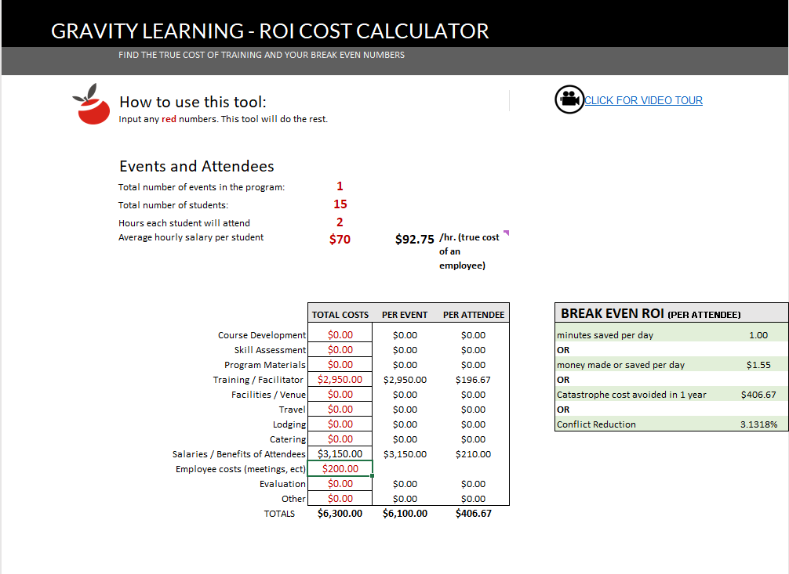
GET THE TRUE COST OF LEARNING
INCLUDE EVERY COST YOU CAN THINK OF
Download the Gravity Learning “Cost Of Learning” Calculator: link
Notes:
ROI CALCULATOR
https://gravitylearning.com/wp-content/uploads/2021/04/Cost-Calculator-for-ROI-Gravity.xlsx

Slide 5
RETURNS
MUST BE CREDIBLE
Estimates must be corrected for confidence. If a resource is 50% confident, include 50% of their estimate.
No value can be assumed. If a value is not reported, zero value is counted.
“How confident are you in the accuracy of that estimate?”
Only quantifiable values are calculated. Intangible benefits certainly have value but are not included in ROI calculations.
“How confident are you that the effect was due to training?”
Ask for examples. Without examples, improvement measurements can be hard to trust.

Slide 6
MEASURING FOR TIME SAVED
Time Saved: How much time do you save as a result of your behavior changes??
ASK FOR AND REPORT EXAMPLES!
Time Saved for Others How much time do others save as a result of your behavior changes?
Confidence: How confident are you that you’re saving at least that much time? Reduce any estimates by the confidence rating.

Slide 7
SOME EMPLOYEES HAVE MORE VALUE THAN OTHERS
EVEN WITH THE SAME:
EXPERIENCE
EDUCATION
INTELLIGENCE
BACKGROUND
WHY?
THEY ARE MORE SKILLED IN KEY COMPETENCIES

Slide 8
OF KEY COMPETENCIES
FIRST
CALCULATE THE VALUE
1.
2.
3.
DETERMINE TARGETED COMPETENCIES
DETERMINE EACH COMPETENCY’S RESPONSIBILITY FOR SUCCESS
MULTIPLY % VS. SALARY TO GET VALUE OF COMPETENCY
Notes:
Assess the extent to which each competency contributes to success in the role.

Slide 9
MEASURE THE VALUE OF COMPETENCY GAIN
Rate a participant before and after learning on how closely they meet expectations for a competency.
Use a -4 to 4 scale where 0 is expected value
Each number from 0 is worth 25% of the competency
UTILITY MEASUREMENTS
Download the Gravity Learning Utility ROI Calculator: link
Notes:
DOWNLOAD THE UTILITY MEASUREMENT CALCULATOR: https://gravitylearning.sharepoint.com/:x:/s/GravityLearningDocuments/Ee28u2VWsfhKmFq8Np4I6swBKdcbo9eNnj1Dh6l6pF-m0Q?e=4ibncv
Determine competencies for a role.
Then determine how much success in the role each competency is responsible for. For example, competency in SQL might have a full 50% to do with job success. On a 100K salary, satisfactory SQL skills would be “worth” 50K.
Determine an employee’s current competency level -4 to 4
-4: This employees skill level is harmful to the org and costs at least the expected value
0: This employee demonstrates the minimum skill needed for job success (they are “worth it” to the org) If an employee is evaluated at a 5, their SQL skills are worth 50K.
4: This employee demonstrates skill that gains the org at least double the expected
After training, the employee is evaluated again, and each skill point change is worth 25% of 50K, or $12.5K

Slide 10
PEOPLE SKILLS
COMMUNICATION
MANAGEMENT SKILLS
GET TARGETED CUSTOMIZATION OR LEVERAGE "READY TO GO" WORKSHOPS
PRODUCTIVITY
DATA AND VISUALS
SOFTWARE AND TECH
Together we can affect and prove something meaningful.
PROJECT MANAGEMENT
L&D CONSULTING
www.gravitylearning.com
Notes:
Visit us on the web at: www.gravitylearning.com
Talk to you soon,
- The Team at Gravity Learning

