Slide 1
SOFT-SKILLS, MANAGEMENT, & TECHNOLOGY WORKSHOPS
HOW GRAVITY GETS ROI
FOR LEARNING PROGRAMS

Slide 2
CAN ONLY HAPPEN
ROI
IF THERE IS LEARNING TRANSFER

Slide 3
GRAVITY MULTI-TOUCH LEARNING PROGRAM

Slide 4
SPREAD OUT THE SESSIONS
SURGEONS WHO SPREAD OUT PRACTICE SESSIONS ARE SIGNIFICANTLY BETTER AT PERFORMING THE SURGERY
STUDENTS WHO SPREAD OUT LEARNING SESSIONS PERFORM 20% BETTER ON UNANNOUNCED TESTS
20% IS THE DIFFERENCE BETWEEN AN “A-” AND A “C-”
Source:
The Journal of Educational Research (1981) Journal of Physical Therapy Education (2007)
Notes:
Bloom, Kristine C., and Thomas J. Shuell. "Effects of massed and distributed practice on the learning and retention of second-language vocabulary." The Journal of Educational Research 74.4 (1981): 245-248.
Lowenthal, J. (2007). Teaching surgical skills: what kind of practice makes perfect?: a randomized, controlled trial. Journal of Physical Therapy Education, 21(1), 78.

Slide 5
1
Reaction: What is the initial response to the learning?
THEN WE MEASURE THE HECK OUT OF RESULTS
2
Learning:
Did people learn anything?
3
Behavior:
Did learners take action later?
Learning programs without strong measurements never really satisfy decision makers.
4
Results:
Did their actions make an impact?
5
ROI:
Was it worth the money?
Notes:
We are super nerdily into measuring learning effectiveness.
If you'd like to learn about how we do it, here's a slightly nerdy article that explains the whole thing: https://gravitylearning.com/the-ultimate-guide-to-measuring-learning-and-roi/

Slide 6
THE ROI FORMULA:
GROSS RETURN - COST
x 100
COST

Slide 7
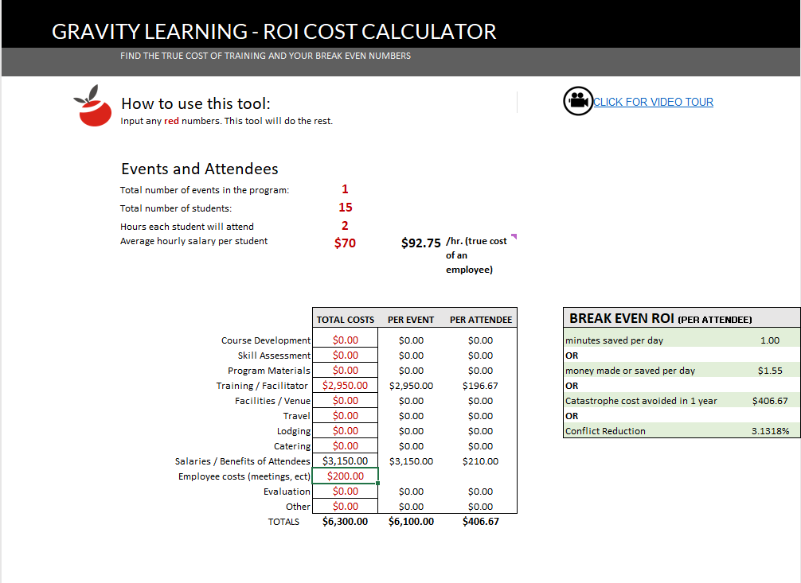
GET THE TRUE COST OF LEARNING
INCLUDE EVERY COST YOU CAN THINK OF
Download the Gravity Learning “Cost Of Learning” Calculator: link
Notes:
ROI CALCULATOR
https://gravitylearning.com/wp-content/uploads/2021/04/Cost-Calculator-for-ROI-Gravity.xlsx

Slide 8
GROSS “RETURNS”
MUST BE CREDIBLE
All data is error corrected for confidence. If a resource is 50% confident, we include 50% of their estimate.
No value is assumed or averaged. If a value is not reported, zero value is counted.
“How confident are you in the accuracy of that estimate?”
Only quantifiable values are calculated. Intangible benefits certainly have value but are not included in ROI calculations.
“How confident are you that the effect was due to training?”
ROI is calculated for the first year, only. Expect most projects to show multi-year benefits.

Slide 9
MEASURING FOR RETURN
Time: How much time do you save as a result of the learning?
EACH MEASUREMENT MUST BE CORRECTED FOR CONFIDENCE AND/OR TO ISOLATE THE EFFECT OF THE LEARNING
ASK FOR AND REPORT EXAMPLES
Effectiveness How much more do you get done, or how much better is the result?
Notes:
We are super nerdily into measuring learning effectiveness.
If you'd like to learn about how we do it, here's a slightly nerdy article that explains the whole thing: https://gravitylearning.com/the-ultimate-guide-to-measuring-learning-and-roi/

Slide 10
WHEN THE BENEFIT IS HARDER TO MEASURE
Determine competencies for a role, and what % of success each competency is responsible for.
Rate the employee on each competency (0-9) before and after learning.
Each point gain is worth 25% of the competency’s monetary value
UTILITY MEASUREMENTS
Download the Gravity Learning Utility ROI Calculator: link
Notes:
Download the Gravity Learning ROI Utility Calculator: https://docs.google.com/spreadsheets/d/1Jlu7Grq9aiy3lqqAegdUY8LZKQmKs-DH/edit?usp=sharing&ouid=108711062352513955567&rtpof=true&sd=true
Determine competencies for a role.
Then determine how much success in the role each competency is responsible for. For example, competency in SQL might have a full 50% to do with job success. On a 100K salary, satisfactory SQL skills would be “worth” 50K.
Determine an employee’s current competency level 1-9:
0: This employees skill level provides zero or negative value to the org
5: This employee demonstrates the minimum skill needed for job success (they are “worth it” to the org) If an employee is evaluated at a 5, their SQL skills are worth 50K.
9: This employee demonstrates skill that doubles value for the org
After training, the employee is evaluated again, and each skill point change is worth 25% of 50K, or $12.5K

Slide 11
PEOPLE SKILLS
COMMUNICATION
MANAGEMENT SKILLS
GET TARGETED CUSTOMIZATION OR LEVERAGE "READY TO GO" WORKSHOPS
PRODUCTIVITY
DATA AND VISUALS
SOFTWARE AND TECH
Together we can affect and prove something meaningful.
PROJECT MANAGEMENT
L&D CONSULTING
www.gravitylearning.com
Notes:
Visit us on the web at: www.gravitylearning.com
Talk to you soon,
- The Team at Gravity Learning

