Slide 1


SOFT-SKILLS, MANAGEMENT, & TECHNOLOGY WORKSHOPS
HOW GRAVITY GETS 180%
BETTER LEARNING RESULTS
WITH THIS SIMPLE STRUCTURE

Slide 2

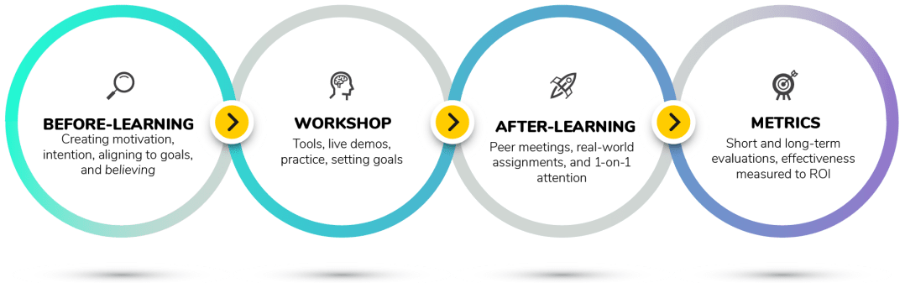
OUR MULTI-TOUCH LEARNING MODEL

Slide 3

MULTI-TOUCH LEARNING
LEADS TO AN AVERAGE OF
180%
BETTER LEARNING RESULTS
Source:
Leimbach, Michael. "Learning transfer model: a research‐driven approach to enhancing learning effectiveness." Industrial and Commercial Training (2010).
Notes:
A Meta analytic published in the Journal of Industrial and Commercial Training analyzed 32 studies comparing single-touch training versus a multi-touch training experience.
The study found that on average, a multi-strategy, multi-touch learning program leads to an average of 180% better results. It is important to note that 180% is an average not an “up to” number. You will probably do much better than 180%, on account of your awesomeness.
The comparison measured “learning transfer”-- whether people actually apply the learning on the job.
When done correctly, learning in a series increases application of the learning an average of 180%. That’s not an “up to” increase. That’s the average!
Source:
Leimbach, Michael. "Learning transfer model: a research‐driven approach to enhancing learning effectiveness." Industrial and Commercial Training (2010).

Slide 4

180%? THAT’S HARD TO BELIEVE!
WELL, IMAGINE YOU TOOK A 2-HOUR GRAVITY “MULTI-TOUCH”
CHANGE MANAGEMENT WORKSHOP
BEFORE THE WORKSHOP
DURING THE WORKSHOP
AFTER THE WORKSHOP
Your leaders created motivation before the workshop.
You heard about the content and intended to use it .
You thought about how the content would align to your personal goals.
You learned real-world tools not just concepts
You saw people demonstrate the tools.
You got a chance to try them yourself in the workshop
You scheduled tasks to apply the tools after the workshop
You met up with people and discussed the learning.
Your manager checked in with you and asked you about the learning.
You reviewed the subject matter a bit.
You applied the learning to something real
- THEN, YOU USED 5 OR 6 THINGS FROM THE WORKSHOP IN REAL LIFE -
Notes:
Mathematically 5.6 is 180% of 2

Slide 5

NOW…
INSTEAD, IMAGINE YOU TOOK A 2-HOUR “ONE AND DONE”
CHANGE MANAGEMENT WORKSHOP
AFTER THE WORKSHOP
You… went back to work.
THEN, YOU APPLIED 2 THINGS FROM THE WORKSHOP IN REAL LIFE
THAT’S A 180% DIFFERENCE

Slide 6

SHOW ME THE
HOW
WHAT DO I HAVE TO DO TO GET 180% BETTER LEARNING PROGRAMS?

Slide 7
BEFORE LEARNING
GRAVITY PROGRAM DESIGN : 70% AVERAGE BOOST
+24%: INCREASE MOTIVATION
GET LEADERSHIP INVOLVED & VOCAL - “SELL THE LEARNING” VIDEOS - 1-ON-1 MEETINGS – SHORT MOTIVATIONAL VIDEOS
+18%: INCREASE INTENTION TO USE
DIRECTLY ASK “DO YOU INTEND TO USE THIS” - BONUS QUICK LEARN VIDEO – MAKE IT LOOK EASY - LIGHTHEARTED APPROACH – PROVE WITH RESEARCH
+17%: ALIGN CONTENT TO CAREER GOALS
PROMPT MANAGERS TO DIRECTLY ASK – DIRECTLY ASK DURING ONBOARDING OR 1-ON-1
+11%: BOOST BELIEF IN ABILITY TO LEARN
TRANSPARENT PROCESS - SHARE OUR CHALLENGES – BONUS QUICK LEARN VIDEOS - LIGHTHEARTED APPROACH
Source:
Frontiers in Psychology (2019)
Notes:
A note about how we create intention to use:
A 2019 study published in the “Frontiers in Psychology” journal show that we set intention to behave in a certain way, when the following is true:
If we expect to enjoy ourselves.
If we trust that the behavior will actually work.
If the behavior isn’t too difficult
We design all of our early messaging around the 3 factors.
Chao, C. M. (2019). Factors determining the behavioral intention to use mobile learning: An application and extension of the UTAUT model. Frontiers in psychology, 10, 1652.

Slide 8
DURING LEARNING
GRAVITY TEACHING MODEL: 26% AVERAGE BOOST
+15%: DEMONSTRATE SKILLS, THEN PRACTICE HANDS-ON
+11%: PARTICIPANTS MAKE A SPECIFIC PLAN
Notes:
We pride ourselves on our step-by-step model of teaching that include all the above, and more (including fun!)
Reveal a Need
We discuss real-life problems to solve and get buy-in.
Discussion
What do attendees currently do? Would learning a new skill be worth it?
Learn a Usable Tool
Good tools in the business world are step-based, sensible, and actually work. We explain and demonstrate to make sure everyone understands.
Real-world Practice
People learn by doing. Gravity students practice using tools in authentic situations.
Make Plans
Attendees create goals, action plans and decide how they'll use their new tools back at work.

Slide 9
AFTER LEARNING
GRAVITY PROGRAM DESIGN: 86% BOOST
+33%: PEERS MEET OUTSIDE OF THE CLASSROOM
ALL WORKSHOPS INCLUDE PEER PARTNERING
+25%: MANAGERIAL SUPPORT
MANAGERIAL BRIEFING & SUPPORT GUIDE
+17%: CONNECT THE CONTENT TO THE JOB
PEER DISCUSSIONS & REAL-WORLD ASSIGNMENTS - FOLLOW-UP SUPPORT AND EVALUATION
+11%: REVIEW THE CONTENT
DRIP CAMPAIGN: REMINDERS, NINJA REVIEW “QUIZZES” - EVALUATIONS

Slide 10

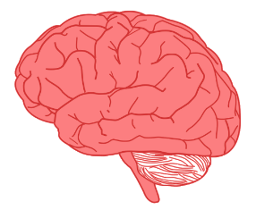
EXPERIENTIAL LEARNING
IT’S HOW WE LEARN IN REAL LIFE – IT’S WHAT WE DO IN THE CLASSROOM
EXPERIENCE
REFLECTION
ANALYZE AND THINK
DO SOMETHING
1
2
3
4
Notes:
In real life we go through a learning cycle that often does not appear in the classroom. At Gravity, we tried to activate as many parts of your brain as we can during learning.
We do this by revealing a need, having personal discussions, learning usable tools, practicing them hands-on, and then making real-world plans.
THE BRAIN ACTIVITY OF OUR EXPERIENTIAL LEARNING METHOD:
Experience –sensory cortex (rear of brain) – This is where we experience life. During a workshop people talk about their experiences and tie content to real life. When attendees learn a tool, they practice it live, and the experiential cycle begins again. It’s the circle of life.
Reflection –integrative cortex (lower-mid part of brain) – Here we let things simmer and think about how they connect to our lives. In workshops we explore challenges and think about how we’d like things to be.
Thinking & Analyzing –front integrative cortex (front of brain) When we discover a need, the front integrative cortex gets creative trying to figure out a solution. In our workshops, we’re nice enough to provide the solution in the form of a real-world tool people can use right away.
Action (do something) – driven by the motor cortex – Learning without action is just a hope. All skills are immediately applied in ravity workshops.

Slide 11
EXPERIENTIAL LEARNING
IT’S HOW WE LEARN IN REAL LIFE – IT’S WHAT WE DO IN THE CLASSROOM
EXPERIENCE
REFLECTION
ANALYZE AND THINK
DO SOMETHING
1
2
3
4
Notes:
In real life we go through a learning cycle that often does not appear in the classroom. At Gravity, we tried to activate as many parts of your brain as we can during learning.
We do this by revealing a need, having personal discussions, learning usable tools, practicing them hands-on, and then making real-world plans.
THE BRAIN ACTIVITY OF OUR EXPERIENTIAL LEARNING METHOD:
Experience –sensory cortex (rear of brain) – This is where we experience life. During a workshop people talk about their experiences and tie content to real life. When attendees learn a tool, they practice it live, and the experiential cycle begins again. It’s the circle of life.
Reflection –integrative cortex (lower-mid part of brain) – Here we let things simmer and think about how they connect to our lives. In workshops we explore challenges and think about how we’d like things to be.
Thinking & Analyzing –front integrative cortex (front of brain) When we discover a need, the front integrative cortex gets creative trying to figure out a solution. In our workshops, we’re nice enough to provide the solution in the form of a real-world tool people can use right away.
Action (do something) – driven by the motor cortex – Learning without action is just a hope. All skills are immediately applied in ravity workshops.

Slide 12

ACTIVE LEARNING:
83% INCREASE IN POSITIVE EXPERIENCE
TALK
MAKING PLANS
PRACTICE
INTERACT
SOLVING PROBLEMS
PLAY
WORK IN GROUPS
EXPERIMENT
Source:
British Educational Research Journal (2019)
Source:
British Educational Research Journal (2019)
Notes:
People don't learn by just listening. What's also true is people don't learn by just doing. We try to blend a perfect mix of intellectual understanding with physical activity. We use brains and bodies.

Slide 13

1
Reaction:
What is the initial response to the learning?
THEN, WE MEASURE THE HECK OUT OF RESULTS
2
Learning:
Did people learn anything?
3
Behavior:
Did learners take action later?
Learning programs without strong measurements never really satisfy decision makers.
4
Results:
Did their actions make an impact?
5
ROI:
Was it worth the money?
Notes:
We are super nerdily into measuring learning effectiveness.
If you'd like to learn about how we do it, here's a slightly nerdy article that explains the whole thing:
https://gravitylearning.com/the-ultimate-guide-to-measuring-learning-and-roi/

Slide 14

BRANDING AVAILABLE
1
Reaction:
What is the initial response to the learning?
THEN, WE MEASURE THE HECK OUT OF RESULTS
2
Learning:
Did people learn anything?
3
Behavior:
Did learners take action later?
Learning programs without strong measurements never really satisfy decision makers.
4
Results:
Did their actions make an impact?
5
ROI:
Was it worth the money?
Notes:
We are super nerdily into measuring learning effectiveness.
If you'd like to learn about how we do it, here's a slightly nerdy article that explains the whole thing:
https://gravitylearning.com/the-ultimate-guide-to-measuring-learning-and-roi/

Slide 15


PEOPLE SKILLS
COMMUNICATION
MANAGEMENT SKILLS
GET TARGETED CUSTOMIZATION OR LEVERAGE "READY TO GO" WORKSHOPS
PRODUCTIVITY
DATA AND VISUALS
SOFTWARE AND TECH
Together we can affect and prove something meaningful.
PROJECT MANAGEMENT
L&D CONSULTING
www.gravitylearning.com
Notes:
Visit us on the web at:
www.gravitylearning.com
Why wait? Call us at:
(415) 273-9772
Talk to you soon,
- The Team at Gravity Learning

